Slide 1
Infosys Hi Tech Competitor Intelligence Report
Corporate Marketing & High Tech Marketing
TCS Internal
October 15, 2013

Slide 2
Table of Contents
Executive Summary
Infosys High Tech Evolution, Sub segments and Value chain
Financials Revenue Distribution Segment wise
High Tech clients as per segment
High Tech focus segments
Global Delivery Centers
Key Offerings in High Tech
High Tech Differentiators – Focus on R&D
Alliance and Partnership
Key Acquisitions
Analyst Benchmarking
Key Investments and Focus of Future Investment
SWOT Analysis
Key Executives and profiles

Slide 3
Executive Summary - High Tech
High Tech Segments and Focus Areas -
High Technology is a segment of Manufacturing vertical is approximately 30 to 35% of the Manufacturing vertical which comes to $ 600 –
650 Million. (Note - Approximation arrived as per vertical segments and client base). Infosys also focuses on Software, Semiconductor,
Computer Platform and Storage, Electronics and Professional Services segments.
Infosys wants to maximize its efficiency across the value chain of HiTech OEM clients, by taking advantage of new delivery mechanisms
like cloud and streaming media and by leveraging solutions and accelerators across engineering, SCM, sales, and beyond.
Infosys is eying at these areas for future investment on Digital Marketing, mobility, digital commerce, social media, Apps Store etc and it want to combine mobility along with in-store awareness. It wants to attain a strong competitive advantage to its competitors with help of this offering.
Infosys is in Execution zone for R&D area for Computer peripheral & storage devices, Consumer Electronics and leader in a Enterprise and Consumer Software as per Zinnov’s 2013 Global R&D Service Provider Rating
The strength of Infosys is its technological competency in implementation of SAP, CRM, SCM & customize the solution according to clients’ requirements.
Key Customer and Relationships in High Tech -
Infosys key clients in High Tech segments are:
Computer Platform and Storage - 1) Apple 2) NetApp 3) Toshiba 4) Hitachi5) Ricoh 6) Xerox 7) HP
Software segment - 1) Microsoft 2) Tibco 3)Novell 4) Salesforce 5) Teradata 6) JDA Software group
Electronics - 1) Royal Philips Electronic 2)Arrow Electronics
Professional Services - 1) Pricewatehousecoopers 2)Arrow Electronics
Semiconductor - 1) Intel 2) Masked customer 2
Infosys partnering with the world’s top software vendors like 1) Microsoft 2) SAP AG 3) HP 4)IBM 5)Oracle and others

Slide 4
Infosys High Tech Evolution
2005
2007-08
2009-2010
2012-13
In 2005, Infosys Technologies (Shanghai) Co. - Chinese subsidiary of Infosys, signed letters of intent with Shanghai
Zhangjiang (Group) and with Administrative Commission of Hanghzhou Hi-Tech Development Industry Zone-Hangzhou to set up software development centers in
China.
Infosys also expanded its relationship with Microsoft through the establishment Of dedicated vendor Offshore facility (VOF) and Microsoft dynamics concept center.
In 2006, it won a consulting deal with Northstar Systems International.
In July 2007, it signed agreement with Royal Philips Electronics to provide F&A services and processing of Purchasing orders.
It acquired the business lines, worth $250m, from Royal Philips Electronics.
Infosys and TIBCO S/W announced significant expansion to their 10-year partnership to ensure successful implementation of SOA.
In Jan 2008, Infosys entered into agreement with Provenir, provider of enterprise customer lifecycle management s/w for financial services, to provide professional services.
In Feb 2008, Infosys signed MOU for strategic business deployment and joint development for sales and solution service offering with Nihon Unisys, Japan.
Microsoft and Infosys entered into go-to-market alliance focused on improving supply chain visibility and collaboration for manufacturers.
In November 2009, Infosys teamed up with Oracle Corp. through BPO powered by Oracle program and launched comprehensive managed services platform for multi-function HR through Infosys Business platforms offering.
Infosys and NVIDIA Corp. entered into a partnership to develop Nvidia Cuda— compute unified device architecture--technology- enabled software solutions.
Infosys successfully integrated Volantis Systems Ubik.com service with Windows Azure resulting in significant performance improvements and cost savings.
Infosys completed its acquisition with Lodestone Holding AG ,a Global Consulting group on October 2012.
Today Infosys has following clients from HiTech such as Apple, Xerox, HP, Microsoft, Intel, Royal Philips Electronics, PwC
Infosys has been ranked as a leader in The Forrester Wave™: Enterprise Mobility Services, Q1 2013 report.
Infosys has been ranked No.1 among the best managed companies in Asia Pacific in the annual Euromoney Best Managed Companies in Asia survey, 2013
Notes:
http://www.infosys.com/about/awards/Pages/all-awards.aspx?cat=All
http://globalbb.onesource.com/web/Reports/ReportMain.aspx?KeyID=170721&Process=CP&Report=SIGDEVS

Slide 5
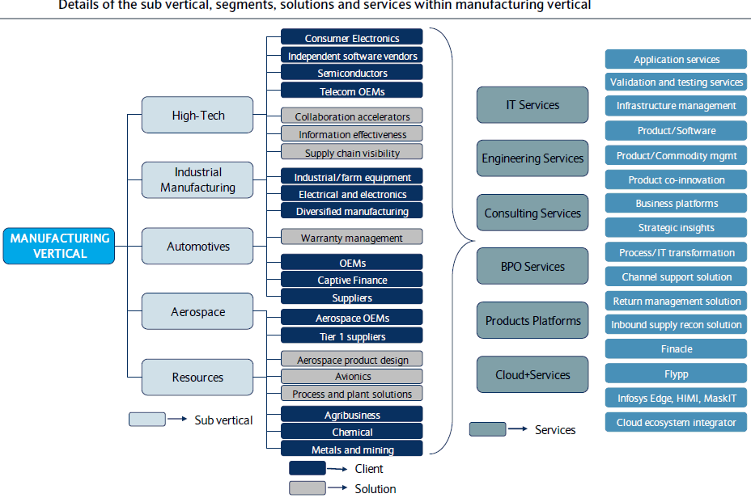
Infosys Manufacturing Sub Segments
Source - Barclays Capital

Slide 6
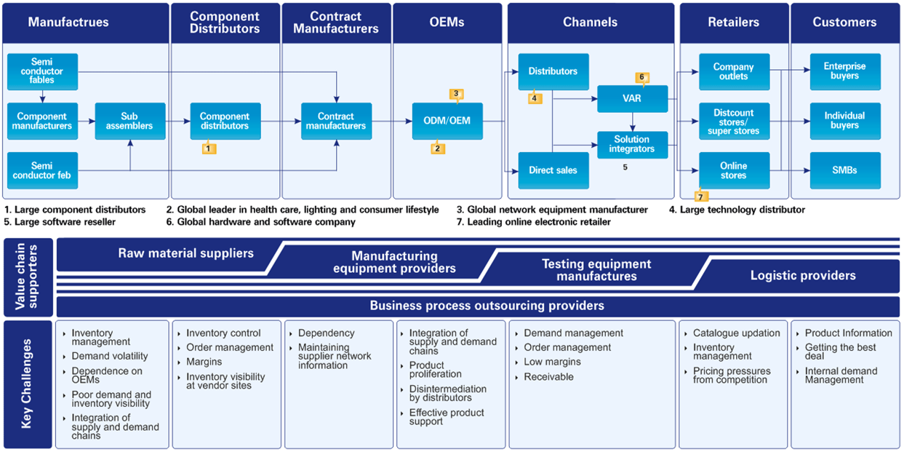
Infosys High Tech Value Chain / Eco System
Notes:
http://www.infosysbpo.com/SiteCollectionImages/high-tech-illustration.gif

Slide 7
Infosys Financial Distribution
Segment wise Revenue FY13 Vs FY12
Verticals | FY2013 (in USD m) | FY2012 (in USD m) | Y-o-Y Growth rate
Financial services & Insurance | 2516.5 | 2469.8 | 1.89%
Manufacturing | 1635.0 | 1447.5 | 12.95%
Energy, Utilities & Communications services | 1495.4 | 1509.9 | .96%
Retail, Logistics, CPG & Life Sciences | 1776.1 | 1615.7 | 9.92%
Total | 7423 | 7042.9 | 5.39%
High Technology is a segment of a Manufacturing vertical which is an annual revenue reporting segment for company.
Infosys’s High Tech revenue is nearly about 35% of the total Manufacturing revenue which comes out approximately to $ 600 – 650 Million (Note – Approximation arrived as per vertical segments and client base)
Infosys’s High Tech and Manufacturing verticals has growth significantly in last couple of Financial years. Last YoY growth attributes to 13%
Notes:
http://globalbb.onesource.com/Web/Reports/ReportMain.aspx?KeyID=170721&Process=CP&Report=busseg

Slide 8
Infosys High Tech Segment Wise Clients
Sr. No. | Client Name | HiTech Segment | Deal Description | Link
1 | Apple | Computer Platform | Infy has rented 1.4 lakh sqft office space to house 1,400 Apple dedicated employees may mean an additional revenue of at least $65 million every year for Infy. Infosys already receives $50 mn in annual revenue from Apple. Infy has worked on applications for Apple's iCloud and Retail Store 2.0 | Link
2 | Toshiba America | Computer Platform | Infosys deploys Oracle e-business suite across four Toshiba divisions | Link
3 | Hitachi Data Systems | Computer Platform | The deployments are based on the recently announced Hitachi Unified Compute Platform (UCP) Select for Microsoft Exchange Server 2010. | Link
4 | Ricoh America | Computer Platform | Ricoh worked with Data Systems International and Infosys to implement Oracle Warehouse Management and Oracle Transportation Management and integrate the applications with the full enterprise resource planning (ERP) system | Link
5 | Xerox | Computer Platform | Xerox provides the document industry's broadest portfolio of offerings. Digital systems include color and black-and-white printing and publishing systems, digital presses and "book factories," multi-function devices, laser and solid ink network printers, copiers and fax machines. | Link
6 | Hewlett-Packard Company | Computer Platform | Infosys proactively leverage expertise and HP’s strengths to deliver services and products in the areas of Data Center Automation, Non-Stop Computing, Service Management, Network Management, SOA, Testing and Quality. | Link
7 | Net App | Computer Platform | Infosys is a NetApp Global System Integrator with a specific focus on cloud services and big-data analytics. | Link
8 | Royal Philip Electronics | Electronics | Infosys bags $250-million Philips deal to increase its footprint in Europe by signing a $250-million outsourcing contract with Royal Philips Electronics of the Netherlands. As part of the agreement, Philips will enter into a seven-year contract with Infosys BPO which will provide finance and accounting (F&A) services and the processing of purchasing orders. | Link
9 | Arrow Electronics | Electronics | Arrow chose Infosys to re engineer, develop, deploy & maintain control system for service operation. | Link
10 | Microsoft | Software | Microsoft outsources internal IT to Infosys - Help desk, desk-side services, infrastructure, and application support have been outsourced to the Indian firm | Link
11 | Tibco | Software | Infosys and TIBCO Software Inc. work together to provide integration of TIBCO's entire product line. Infosys has established a Center of Excellence for TIBCO, and Adapter Competency Center (ACC), which was started in 2001. | Link
12 | Novell | Software | With its infrastructure software and partnership with Infosys, Novell integrates mixed IT environments, allowing people and technology to work as one. | Link

Slide 9
Infosys High Tech Segment Wise Clients
Sr. No. | Client Description | Segment | Deal Description | Link
13 | Salesforce.com | Software | Infosys offers expertise and skills in SFDC domain, project, and program management for large or complex SFDC deployments. | Link
14 | Teradata | Software | Teradata delivers award-winning, integrated, purpose-built platforms based on the most powerful, scalable, and reliable technology platform in the industry. | Link
15 | JDA Software Group | Software | With an integrated solutions offering that spans the entire supply chain from materials to the consumer, JDA leverages the powerful heritage and knowledge capital of acquired market leaders including i2 Technologies, Manugistics, E3, Intactix and Arthur. | Link
16 | Intel | Semiconductor | Intel has awarded a pilot outsourcing contract to Infosys Technologies worth $10 million | Link
17 | Semi Leader (Masked) | Semiconductor | Leader in Semiconductor technology rides on eCommerce to drive sales | Link
18 | PwC | Professional Services | PwC outsource its back office work to Infosys | Link
19 | Dentsu | Professional Services | Infosys Edge has been selected by Dentsu Global Project team to deliver a single, unified platform for driving projects and campaigns spanning multiple countries and regions. | Link

Slide 10
Infosys High Tech Contracts from IDC D/B
Customer Name | Industry | Geography Scope/Country | Deal Value (USD) | Date
Lloyd's Register Group | Professional Services | Latin America, Asia Pacific excluding Japan (APEJ), Japan, Middle East & Africa, Central & Eastern Europe, Western Europe, North America | 23,734,178 | April, 2012
Microsoft Corporation | Software |  | 450,000,000 | Mar, 2010
Philips Do Brasil Ltd | Electronics | Latin America | 7000000 | Dec, 2009
Intel Corporation | Semiconductor | North America, USA | 10,000,000 | Jul, 2009
Dentsu Inc. | Professional Services | Japan | 322,372 | Mar, 13

Slide 11


Infosys High Tech Segment Focus
Consumer Electronics
Infosys Take on the Industry
The consumer electronics industry is in an exciting phase today with its expansion being driven by a blend of traditional and modern devices. With shorter cycles, smaller devices and smarter consumers being the order of the day for consumer electronics enterprises, the way of the future is to get leaner, inventive and connected.
Industry players can realize all this by being at the confluence of convergence and consumer – by maximizing efficiency across their value chain, by taking advantage of new delivery mechanisms like cloud and streaming media and by leveraging solutions and accelerators across engineering, SCM, sales, and beyond.
Challenges and opportunities
Reaching out to the 'new' consumer: Today's consumers are aware and empowered. They talk to each other about their brand experiences, and advertise their loyalties on their social media profiles. Their influence only continues to grow with their voices influencing technology choices at enterprises, making it that much more important for consumer electronics players to stay connected.
Intensely competitive landscape: In "the price is right" economy, ground realities are lively price competition, lower rates of return and the threat of substitution and cannibalization by newer products. To stay ahead, companies need to make their devices stand out and look to emerging economies as a means of fuelling sustainable growth.
Diversity of content and devices: Each new device, each new content format is a new variable in an already-complex and diverse ecosystem, and getting more complex with each passing quarter. So with a plethora of additive devices flooding the market with segregated content and networks, the need going forward is maximized integration among multiple players in their ecosystem, while utilizing new content delivery mechanisms like cloud streaming solutions to corral and connect content seamlessly.
11

Slide 12


Infosys High Tech Segment Focus
Consumer Electronics
Delivering the Solution
Fast-tracking value realization: Infosys works with clients to optimize all aspects of their value chain with technology-led transformative solutions. Harnessing the power of our Value Realization Model, Infosys helps consumer electronics companies tightly integrate business consulting with enterprise solutions delivery, thus creating business-IT maturity that delivers real business return on investment on their consulting and IT initiatives.
Accelerating engineering initiatives and new product development: Product Engineering solutions, Product Lifecycle Management (PLM) solutions and Infosys Labs help clients in concept-to-market R&D and improving engineering product operations to develop differentiated products in a rapidly evolving market – while also enabling them to enhance their existing products in step with emerging technologies. Add to this our digital innovation solutions, and clients get the power to leverage all consumer touch points – from next-gen social commerce to specific retail experiences – to stay ahead of the competition.
Optimized operations: Infosys works with clients to reduce their infrastructure costs with innovative business technology optimization (BTO) solutions and supply chain optimization offerings. Our returns management, reseller/channel management, BPO services and effective post-sales trainings and support for consumers free up valuable resources for clients, helping them focus on what they do best.
Solutions
Infosys SocialEdge™ Platform
Product Engineering solutions
Product Lifecycle Management (PLM) solutions
Business Technology Optimization (BTO) Solutions
Supply Chain Optimization
BPO Services
Cloud Offerings
Consulting Services
Engineering Services
12

Slide 13
Infosys High Tech Segment Focus
Semiconductors
Infosys Take on the Industry
In a market where products that were sensational yesterday become standard today and obsolete tomorrow, Independent Software Vendors (ISVs) are expanding their horizons in a highly dynamic market – from challenging the rationale of traditional partnerships to embracing new business opportunities.
With the growth of cloud computing, the extremely rapid adoption of mobile devices and the constant evolution of consumer interaction, ISVs are finding themselves at the tipping point of game-changing forces that hold the potential to reshape their enterprise.
Challenges and opportunities
Technology obsolescence: Operating in a market which moves at a breakneck pace, software companies are not only striving to keep up with the latest shifts in technology and keep an eye on the next big change, but also to trying to find an effective mechanism to harness disruptive innovation in existing markets and segments.
New business avenues: Exciting opportunities are everywhere — smart phones, tablets, gaming software and cloud computing are just a few of them. Industry leaders are creating expertise as fast as they can by building solutions using these enablers and dealing with varied processes — transforming business risks into new opportunities.
Digital consumers: A significant portion of purchasing power is being devolved to individual knowledge workers and consumers at-large who are adopting latest devices and services in an innovative manner to quickly fulfill their professional and personal needs. Consumers are also demanding increased flexibility and modular structuring of software costs that allow them to pick and choose the services they need.
13

Slide 14
Infosys High Tech Segment Focus
Semiconductors
Delivering the Solution
Accelerating innovation: We leverage our expertise to deliver services across the product lifecycle — from architecting, designing and implementing technology to sustaining technology footprints and supporting associated business processes.
Validation: The defect is in the details. So is perfection. Infosys offers testing services for software enterprises to help ensure product quality before it hits the market. We also provide valuable expertise for enabling revenue maximization once the product is in the marketplace.
Process optimization: With software enterprises needing to cater to millions of customers, Infosys offers 24x7 support capabilities to enhance customer satisfaction and revenue.
Solutions
Cloud Computing Center of Excellence (CoE)
Convergence Center of Excellence (CoE)
Mobility services
Infosys SocialEdge™ Platform
Engineering Services
Infrastructure Services
14

Slide 15
Infosys High Tech Segment Focus
Independent Software Vendor (ISVs)
Infosys Take on the Industry
All silicon is created equal. But silicon solutions are not. Today, manufacturers must constantly go back to the drawing board to create innovative products that can satisfy highly demanding consumers.
The semiconductor industry lives and breathes a simple motto: smaller, faster, smarter and cheaper. Sticking to this motto will require enterprises to identify apertures of possibility that can drive excellence across the board – down to the last transistor.
Challenges and opportunities
Agility: Building a strong ecosystem of hardware and software partnerships is crucial in achieving agility that can address constantly changing technologies and consumer behavior.
Competitiveness: Having to serve highly dynamic customers, semiconductor enterprises must keep looking for new growth engines, new alliances and acquisitions. With their traditional business undergoing constant change, they must look to new and emerging markets which offer exciting growth opportunities.
Complexity: Transformation across semiconductor enterprises is complicated. All partners in the supply chain must be tightly integrated, and technology is a core element in this fabric.
15

Slide 16
Infosys High Tech Segment Focus
Independent Software Vendor (ISVs)
Delivering the Solution
Integrated solutions for ecosystem partnerships: Infosys transforms traditional semiconductor value chains into value webs by leveraging integrated solutions, go-to-market strategies, and marketing and sales transformation programs that bring together varied industry players.
Emphasis on creation of new revenue streams: Infosys co-creates with semiconductor enterprises for next-generation chip sets, functional simulation, design automation, testing, product support services and consulting services.
Powering agile transformation: Our collaboration in supply chain restructuring programs goes beyond reducing cycle times. We lead the way in supporting business operations with touch-less procurement solutions, collaborative outsourced manufacturing, and eCommerce programs.
Solutions
Cloud Offerings
Infosys Digital Smart Home Gateway
Infosys SocialEdge™ Platform
Manufacturing Collaboration Accelerators
Manufacturing Information Effectiveness
Product Lifecycle Management (PLM) solutions
16

Slide 17
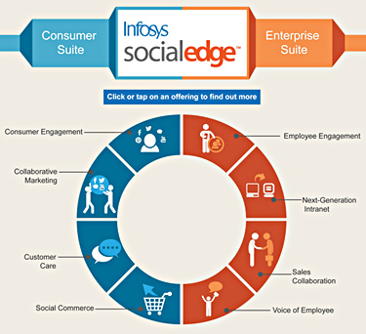
Infosys Social edge Platform
SocialEdge equips enterprise to effectively engage employees, customers and partners. SocialEdge is a comprehensive and easy-to-use social business platform that includes Consumer and Enterprise suite of applications, which address varied external and internal collaboration needs. Built with state-of-the-art technology, the platform provides a seamless experience across devices, including handhelds.
SocialEdge Consumer Suite
Co-create with consumers, deepen relationships, and most importantly, increase revenues from your social business initiatives by using Consumer suite of applications:
Consumer Engagement , Collaborative Marketing , Social Commerce , Customer Care
SocialEdge Enterprise Suite
Empower employees to share ideas, enhance expertise, and win deals with our Enterprise suite of applications:
Employee Engagement , Next-Generation Intranet , Sales Collaboration, Voice of Employee

Slide 18
Infosys Global Delivery Centers
Global Delivery Centers (Snap Shot)
Country | Location
United States | Rockville, Maryland Atlanta (onshore operations center) New Jersey
Brazil | Belo Horizonte
Mexico | Monterrey
Canada | Toronto
China | Hangzhou
Philippines | Manila
India | Bangalore, Chennai, Pune, Gurgaon
Australia | Melbourne
Czech Republic | Brno
Poland | Lodz
Germany | Munich
Costa Rica | San Jose
United Kingdom (UK) | London
Development/Delivery Centers (Snap Shot)
Region
Americas | 22
Asia Pacific | 12
Europe | 20
UK | 4
India | 21
Middle East & Africa | 4
Japan | 2
CareFirst BlueCross BlueShield awarded Infosys Public Services a three-year managed services contract to create a cost effective delivery model and drive efficiencies in application support
Infosys Public Services will set up a secure facility within its newly established delivery center in Rockville, Maryland to service the contract and help CareFirst to consolidate IT support services currently managed by multiple vendors
Infosys has a global footprint with 68 offices and 72 development centers in US, India, China, Australia, Japan, Middle East, UK, Germany, France, Switzerland, Netherlands, Poland, Canada and many other countries. Infosys has established over 12 global delivery centers outside India across Asia, America, and Europe
- 18 -

Slide 19
Infosys Key Offerings
SAP-CRM Expertise | Infosys is an early adaptor of latest technologies like CRM 6.0, CRM 7.0. Infosys leverages SAP CRM’s flexibility, scalability & modular deployment too boost the return on clients’ investments.
Supply Chain Analytics Solution | Infosys comes up with Supply Chain Analytics which help to identify trends, preform comparisons, & highlight opportunities in supply chain functions. It works in Executive Information System ,OLAP and fulfills client’s goals & objectives.
High Tech Distribution Solution | High-Tech Distribution solution includes distributor price protection management and application integration. Oracle and Infosys combine Oracle's best-of-breed applications and technology with Infosys' functional expertise and world-class services to deliver extensive enterprise benefits from integrated innovation. It address challenges such as higher operational costs, lost sales, diminishing margins and shareholder value.
Oracle Application Management Service | Gartner estimates that Infosys has approximately 3,800 FTEs providing Oracle application management services. Infosys' main Oracle application management services markets are financial services, communications, high-tech manufacturing and retail.

Slide 20
Infosys Key Offerings - BigDataEdge
Requirment of Big Data
The scientific & creative analysis of large complex data can generate deeper insight by providing 360 degree perspective by which consumer sentiment, behavior and future trend can be analyzed & properly strategized.
Proper use of Big data management can do this work with the help of proper optimization & analytic tools.
Infosys is providing this Big data solution named as Infosys Big data edge which may help their clients to properly strategize their future planning, improve operational efficiencies & give a competitive advantage.
Infosys BigDataEdge platform
Infosys BigDataEdge is a software platform for empowering both technology and business to rapidly develop industry-specific insights. It enables technology and business users to work together to integrate, aggregate, manage, analyze, disseminate, and act upon large volumes of multi-structured data. This platform incorporates a metadata-based virtual data source with role-based user interfaces and corresponding functionality for each role. The roles are supported by four primary components:
Solution Designer, which is focused on data access and enables the creation of adaptors to various structured, semi-structured, and unstructured data sources. This component supports data integration, aggregation, and transformation utilizing reusable components.
Analyst Workbench, which is focused on data analysis and enables data scientists and business analysts to build insights by exploring data using prepackaged algorithms or using a custom algorithm builder.
Executive Dashboard, which is focused on information display and enables data visualization and action decisions in real time.
Administrative Console, which is focused on functions such as usage monitoring and access rights management
Infosys BigDataEdge Services
Infosys BigDataEdge is available for deployment as on-premise or hosted software and is supported by a range of Infosys professional services such as:
Consulting or strategy services to help organizations build a Big Data road map to realize business benefits.
Deployment and migration services, including migration strategy, deployment of proof of concept, and pilot projects followed by full-fledged deployment of solutions
Management services, including management maintenance and upgrading of the Big Data platform along with development of algorithms and connectors
Notes:
http://www.infosys.com/bigdataedge/resources/Documents/unlocking-business-value.pdf

Slide 21
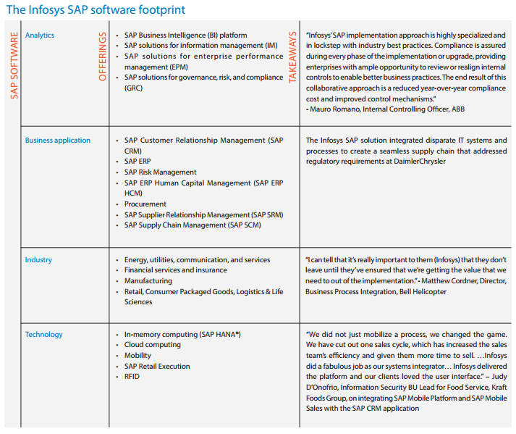
Infosys Key Offerings - SAP
Notes:
http://www.infosys.com/SAP/Documents/SAP-practice-infosys.pdf

Slide 22
Infosys Key Offerings - SAP
Infosys SAP HANA-Overview
SAP HANA optimizes SAP Business Suite processes, leveraging merged online transaction processing (OLTP) and online analytical processing (OLAP) on a single platform. With SAP HANA, organizations can rid their ecosystem of data latency. What’s more, it helps reduce total cost of ownership (TCO) using a simplified architecture.
Infosys offers solutions around SAP BW, SAP CRM and SAP Business Suite migration, transformation services and rapid-deployment to speed the transition to a SAP HANA in-memory database platform. Alongside our proprietary Value Realization methodology (VRM™), these solutions help clients get the most value from their investments in SAP HANA in-memory technology.
Infosys SAP HANA COE serves as a catalyst, providing measurable business results for clients in activities like:
Providing subject matter experts to support the client’s project teams, so they can expedite HANA-based deliveries
Accelerating transition to next-generation business applications and analytics
Developing, testing and providing demos of accelerators and apps – on HANA
Building case studies and business scenarios
Optimizing SAP HANA solutions across the entire life cycle
Streamline HANA project management capabilities using Angel Program
Building and sharing domain knowledge on HANA to help clients achieve more ROI faster
Infosys HANA COE is a nodal point that intersects several core capabilities like onshore–offshore delivery centers; domain experts in multiple business verticals; the SAP Labs–SAP Solution Management Center– Infosys Labs partnership; as well as project teams at client sites.
Infosys partners with SAP to deliver HANA in-memory technology solutions, including BW on HANA, CRM on HANA, Business Suite of HANA and Near Line Storage (NLS). Our offerings help client businesses leverage their tidal wave of enterprise data and, in the process, improve decision-making capabilities across the client organization.
Infosys SAP expertise-Analyst review
Infosys is ranked in the top 'Market Maker' category for SAP services in Asia-Pacific, according to the capioIT 2012 Asia-Pacific SAP Services Capture Share Report. CapioIT, an advisory firm specializing in improving business outcomes for buyers of business-driven technology, assessed strengths and weaknesses of 15 SAP services providers in the region. The analysis looks at 17 key capabilities and attributes of services providers across two key dimensions: 'Transform' and 'Leverage'.
Notes:
http://www.infosys.com/SAP/offerings/Pages/memory-analytics-solution.aspx

Slide 23
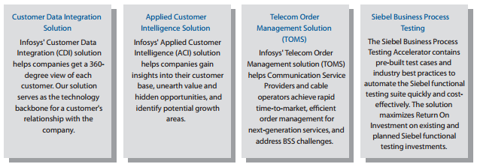
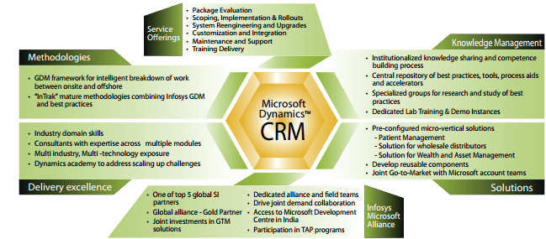
Infosys Key Offerings - CRM
Infosys' Amdocs competency is bolstered by skilled resources, proven tools, methodologies, templates, and accelerators resulting in a CRM solution that is robust and affordable with extensive customization capabilities and integrates easily with the customer's existing enterprise systems. The Amdocs Center of Excellence ensures high-quality strategic package evaluation and roadmap, robust implementations and rollouts, faster upgrades, and dependable production support.
Amdocs CRM
Oracle's Siebel CRM
Microsoft Dynamics CRM
Notes:
http://www.infosys.com/CRM/offerings/Documents/oracle-siebel-CRM.pdf
http://www.infosys.com/CRM/offerings/Pages/packages.aspx
http://www.infosys.com/microsoft/resource-center/Documents/microsoft-dynamics-CRM.pdf

Slide 24
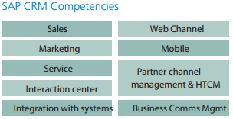
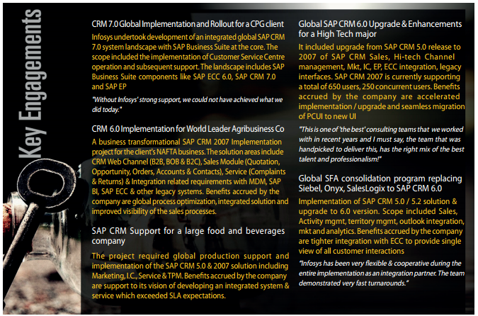
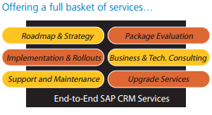
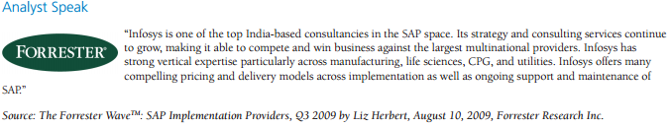
Infosys Key Offerings - CRM
SAP CRM
Notes:
http://www.infosys.com/CRM/offerings/Pages/packages.aspx

Slide 25
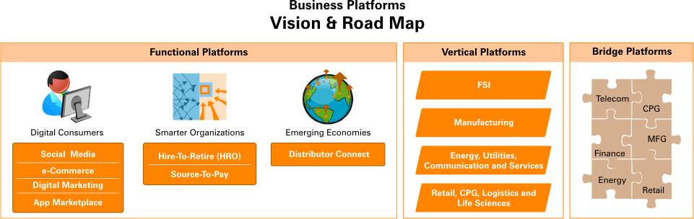
Infosys Key Offerings - Edge Platform Cloud
Services Platform wise
Functional platforms that cut across business verticals and address enterprise themes such as digital consumers, smarter organizations, and emerging economies
Vertical platforms that address specific industry segments such as banking, retail and manufacturing
Bridge platforms that target niche industries, which exist at the confluence of industry verticals, and include futuristic platforms from the Infosys Edge portfolio of business platforms in the cloud
Different platforms
Benefits
Top-line growth through offerings that answer your need for transformation and innovation
Bottom-line efficiencies through process standardization, capex-to-opex conversion and outcome-based pricing
Enhanced experience by providing a single point of accountability and service assurance, based on service level agreements (SLAs)

Slide 26
High Tech Differentiators – Focus on R&D
Research &Development and focus on Innovation
Infosys Labs dedicated research group comprising technology and domain-focused members and is built on the successes of the award-winning Software Engineering and Technology Labs (SETLabs).
Its Centre of Innovation for Tomorrow’s Enterprise (CITE), which manages the research on the seven core themes for Building Tomorrow’s Enterprise. The themes are focused on Digital Consumers, Emerging Economies, Healthcare Economy, Sustainable Tomorrow, New Commerce, Smarter Organizations and Pervasive Computing.
Under its Center for Enterprise Technology, Infosys Labs focuses on topics such as semantic technology, context-aware systems, intelligent sensing, multi-channel convergence, large data modeling and simulation, next-gen computing platforms visualization, and immersive experiences.
Its Center for Services Innovation focuses on software engineering aspects such as software dependability, preventive maintenance, distributed service delivery, modernization, and automation and optimization.
Infosys Labstorm is the innovation co-creation platform of Infosys. It is a rich media destination for Infosys clients and other stakeholders to experience tangible innovations and research concepts from Infosys and its partners. With access to Infosys Labstorm, a client CXO is transported to Infosys world of innovations – real, tangible, and inspired.
The core element of Infosys’s approach is the Infosys Value Realization Method (VRM), a management framework for maximizing the value return from major IT-enabled investments. Integrated into the fabric of our delivery model, VRM spans initial value discovery and buy-in, to establishing accountability — guiding solution designers, and providing client program managers with benefits tracking and reporting capabilities.
2013 R&D Supplier Ranking by Zinnov
Infosys is placed at Expansive-Established quadrant in R&D practice, innovation, scale & others parameter as per Zinnov Global Service Provider Rating.
Infosys is at the Execution zone in R&D practice, innovation in Computer peripheral & storage devices as per Zinnov Global Service Provider Rating.
Infosys is at the Execution zone in R&D practice, innovation in Consumer electronics as per Zinnov Global Service Provider Rating.
Infosys is at the Leadership zone in R&D practice, innovation in Enterprise software as per Zinnov Global Service Provider Rating.
Infosys is at the Leadership zone in R&D practice, innovation in Consumer software as per Zinnov Global Service Provider Rating.
Infosys is at the Execution zone in R&D practice, innovation in Semiconductor as per Zinnov Global Service Provider Rating.
Notes:
http://www.infosys.com/infosys-labs/Pages/index.aspx
http://www.infosys.com/building-tomorrows-enterprise/pervasive-computing/resources/Documents/smarter-big-data-strategies.pdf

Slide 27
Alliance and Partnership - 2012 and 2013
Date | Application Area | Alliance Partner | Scope of Partnership
Q1 FY 2014 | Autonomics-based managed IT service | IPsoft | IPsoft and Infosys will set up an Autonomics Center of Excellence and an Autonomics Lab at the Infosys Global Education Center in Mysore. The Center of Excellence will focus on developing technical competencies and training of Infosys employees; the Lab will develop proofs of concept and design autonomics solutions for clients
Jun 20, 2013 | Cloud and big data | Open Data Center Alliance | Infosys Joined Open Data Center Alliance As a Contributing Member. Infosys will contribute its proven expertise in cloud and big data to ODCA’s mission of developing a unified vision for an enterprise’s cloud and big data requirements based on open, interoperable standards
May 07, 2013 | Mobile Applications | SAP | Infosys is collaborating with SAP on development of mobile applications for the retail industry. Specifically, Infosys has cooperated with SAP on development of the SAP Retail Execution mobile application version 3.0. The application powers the work Infosys does for CPG companies, along with their merchandisers and promotions planners
- 27 -
Notes:
http://www.infosys.com/investors/reports-filings/quarterly-results/2013-2014/q1/Documents/IFRS-USD-press-release.pdf
http://www.infosys.com/newsroom/press-releases/Pages/open-data-center-alliance-member.aspx
http://www.infosys.com/newsroom/press-releases/Pages/mobile-applications-collaboration.aspx
http://www.infosys.com/newsroom/press-releases/Pages/global-cyber-security-threat.aspx
http://www.infosys.com/newsroom/press-releases/Pages/national-ICT-australia-partnership.aspx
http://www.infosys.com/newsroom/press-releases/Pages/government-business-eBiz-portal.aspx

Slide 28
Alliance and Partnership - 2012 and 2013
Date | Application Area | Alliance Partner | Scope of Partnership
13 Feb 2013 | Hard Technology | National ICT Australia (NICTA) | Australia's premier ICT research organization NICTA and Infosys, have signed a joint research collaboration agreement to tackle the hard technology problems facing businesses
28 June 2013 | Website Development | Ministry Of Commerce And Industry, India | The Department of Industrial Policy and Promotion (DIPP), Ministry of Commerce and Industry - Government of India announced the launch of eBiz – India’s first Government-to-Business (G2B) portal which has been developed by Infosys in a public private partnership model
14-Nov-12 | Cloud Services | Microsoft and Gen-i | Infosys, Microsoft and Gen-i have announced a managed service platform designed to simplify the deployment, management and control of Cloud services for Australian and trans-Tasman enterprises and government agencies.
11-Sep-12 | Customer service | AT&T | Through a jointly developed solution with AT&T, Infosys redefined customer service with SpeedSolve – a comprehensive next-generation product that makes communication faster and more efficient for call centers and related operations.
12-Sep-12 | Engineering information management solutions | AVEVA | AVEVA has inked a partnership deal with Infosys, to jointly offer engineering information management solutions to support the operation and maintenance of process plant and power facilities. With this, Infosys and AVEVA will aim to assist companies exploit information management solutions based on AVEVA s enterprise software.

Slide 29



Alliance Partners
Infosys-Microsoft shared mission to lower the cost of technology ownership and enhance the value realized by clients from their technology investments.
The Alliance enables the development of leading-edge solutions across various industries. It also provides a suite of modular solution offerings, right from deploying a uniform platform to helping the enterprise collaborate seamlessly.
Infosys won Oracle Title partner award at Oracle Openworld 2010.
The areas they are working together are:
Financial Services
Communications, Media and Entertainment
Energy, Utilities and Services
Hi-Tech, Discrete and Process Manufacturing
Insurance and Life Sciences
Retail and Consumer Packaged Goods
Infosys has over 20 Oracle® Centers of Excellence focusing on a wide range of applications and technologies.
Infosys is a Service Partner of SAP in North America, Japan and Australia, recognized by SAP as a Systems Integration partner in RFID. Infosys is an Implementation Partner for SAP Markets, a subsidiary of SAP AG.
As SAP’s strategic services partner, Infosys combines technical and industry-best practices to deliver successful business solutions.
Notes:
http://www.infosys.com/about/alliances/pages/index.aspx

Slide 30
Alliance Partners
Company | Area of Alliance
CA Technologies | Given Infosys' expertise in CA Technologies' focus areas such as Identity and Access Management and IT Governance, CA Technologies is keen on creating a joint value proposition with Infosys for mutual customers.
HP | Infosys is an HP Global Systems Integration Partner with experience across the Hardware, Server, Storage, and HP Business Technology Optimization Product Suite.
IBM | Infosys and IBM have partnered to create solutions across industries including e-commerce in retail, and Customer Data Integration for a major U.S. bank. Infosys has centers of excellence in IBM software including Web Sphere Commerce etc.
INFORMITICA | With the help of Informatica's technical support and product development groups, Infosys has deepened its expertise around Informatica's leading tools and applications.
Salesforce.com | This alliance’s footprint includes skills in Force.com, CRM, Call Centers, and SFA across multiple industries including financial services, manufacturing, communications, energy and utilities, retail, and health and life sciences.
SIEMENS | Infosys is a global alliance partner of Siemens PLM for their Product Lifecycle Management (PLM)-based offerings. Under this agreement, Siemens PLM and Infosys will develop joint solutions and go-to-market plans for specific industries.
TIBCO | Infosys and TIBCO Software Inc. work together to provide integration of TIBCO's entire product line. Infosys provides technical leadership and domain expertise in product features and capabilities.
Autonomy | Autonomy Corporation plc, a global leader in infrastructure software for the enterprise, spearheads the Meaning Based Computing movement. It gives support to Infosys.
Sterling Commerce | Infosys and Sterling Commerce are committed to provide greater experience to customers around the world with proven industry-leading joint solution offerings in e-commerce, order management and B2B connectivity.
Pegasystems | It provides software support to Infosys.
Xerox | Document management technology & service enterprise support to Infosys.
Notes:
http://www.infosys.com/about/alliances/Pages/alliance-partners.aspx

Slide 31
Alliance Partners
Company | Area of Alliance
OSIsoft | OSIsoft® delivers PI System®, the world's leading highly scalable and secure infrastructure for the management of real-time data and events, and for connecting people with the right information, at the right time, to analyze, collaborate, and act. It gives support to Infosys.
NetApp | Infosys is a NetApp Global System Integrator with a specific focus on cloud services and big-data analytics. NetApp creates innovative storage and data management solutions that deliver outstanding cost efficiency and accelerate business breakthroughs.
Hitachi | Infosys is a Hitachi Data Systems (HDS) Strategic Global System Integrator with specific focus on infrastructure transformation solutions in storage, backup and converged solutions. Hitachi Data Systems provides best-in-class information technologies, services and solutions that deliver compelling customer ROI, unmatched return on assets (ROA) and demonstrable business impact.
Notes:
http://www.infosys.com/about/alliances/Pages/alliance-partners.aspx

Slide 32
Key Acquisitions
Company | Area of Business | Value | Location | Date | Deal Description
Lodestone Holding AG | Global management Consultancy firm | CHF 330 m | Zurich | Oct, 2012 | Upon completion, the acquisition of Lodestone will strengthen Infosys Consulting and Systems Integration (C&SI) capabilities, by bringing more than 850 employees, including 750 experienced SAP consultants to the Company. The transaction is currently expected to close by the end of October 2012.
Portland Group Pty Ltd | Provider of strategic sourcing and category management services | AUD 37m | Australia | Jan, 2012 | The acquisition is expected to be completed by early January 2012, subject to certain closing conditions being met. Portland Group`s expertise in strategic sourcing and category management services is expected to complement Infosys`s BPO`s global sourcing & procurement capabilities to create a market offering that will positively impact client`s business efficiency and effectiveness.
Notes:
http://globalbb.onesource.com/web/Reports/ReportMain.aspx?KeyID=170721&Process=CP&Report=SIGDEVS

Slide 33
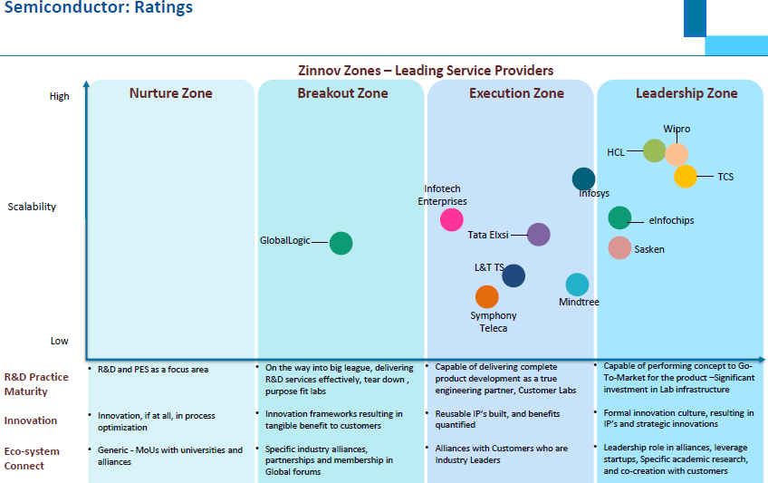
Analyst Benchmarking – 2013 Zinnov R&D

Slide 34
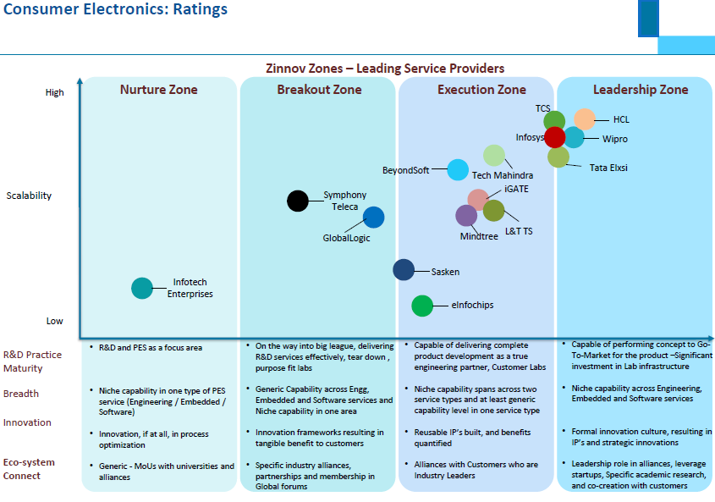
Analyst Benchmarking – 2013 Zinnov R&D

Slide 35
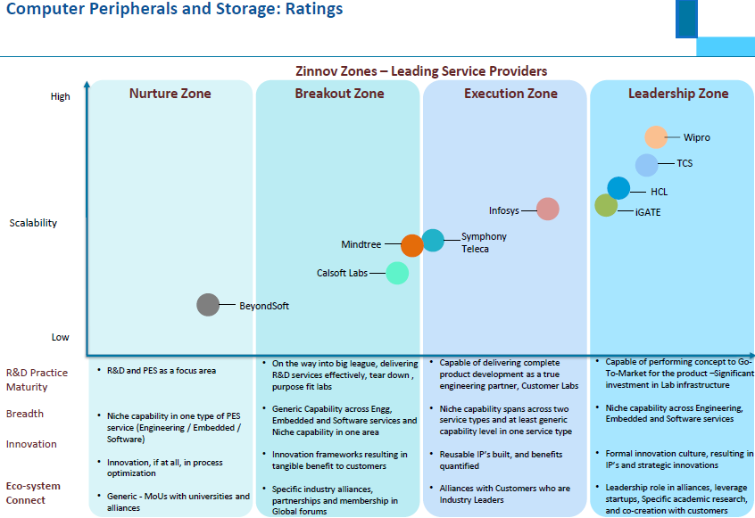
Analyst Benchmarking – 2013 Zinnov R&D

Slide 36
Analyst Benchmarking - Infosys Vs TCS
Technology
Infosys
TCS
Challenger in the Gartner’s Magic Quadrant for SAP application outsourcing
It customizes SAP applications too align it with the client desired business outcome.
Clients indicate Infosys has strong delivery capabilities to support their SAP programs.
Challenger in the Gartner’s Magic quadrant for SAP application outsourcing.
First Indian provider to become a global SAP services partner
Leading offshore firm in the SAP services market.
Challenger in Gartner’s Magic quadrant
.
SAP
(Application Outsourcing)
Infosys is positioned in the Challenger quadrant.
Gartner estimates that Infosys is the fifth largest CRM service provider worldwide, with CRM revenue of about US$500 million.
It earned above average clients’ feedback in skills, technical competencies & largest CRM practices in terms of resources & skill.
Gartner estimates that the TCS growth was among the highest in the market, with a growth rate of about 30% for CRM services in 2011.
Compared with other vendors, TCS had above-average client feedback for technology competencies, including information architecture, analytics, SOA and technical architecture skills.
CRM
(Consulting & Solution implementation)
Infosys is positioned in the leader quadrant. It has been an Oracle Diamond Partner since September 2010.
Infosys enjoys relatively high levels of client satisfaction, due to the quality of its resources, their functional and technical abilities
Leader in Gartner’s Magic quadrant .
TCS is able to deploy a very large number of industry and process assets across all Oracle application platforms, and can offer distinct industry and process solutions for all industries it competes in.
Oracle application management service
BIPM
Gartner’s rating is positive for Infosys’s BIPM.
Infosys helps clients expand business application initiatives with BI capabilities and leverage offshore implementation services.
Gartner’s rating is promising for TCS’s BIPM.
TCS is suited for technology-centric projects, for projects in which information integration is key & enterprise information strategy necessary.
Oracle application management service
Notes:
Gartner reports G00238208, G00231412, G00219672

Slide 37
Key Investments and focus of Future
In Feb 2010,Infosys started investing Australian $8 Million in its newly built data centre at Melbourne to support the growing client demand of cloud services across HR, procurement and other functions.
Infosys has planned to expand Philippine operations from currently existing capacity of 1100 to 3000 expecting an increase in demand of its end to end BPO offerings
2010
May 2011- plans to invest between US$125-150 million in the new campus- at Zizhu Science and Technology Park in Shanghai, China, one of the largest investments in China by a software company.
Feb 2011- Infosys Technologies Expands Operations in Thiruvananthapuram. Inaugurates first Software Development Block (I) at Technopark Campus II (SEZ) with a Total Investment of 180 crore
Sep 2011- Infosys Partners with Singapore Management University for Joint Education and Research Projects
2011
2012
Set aside $ 100 million for products, platforms and solutions and have set up a Non-Functional Requirement Lab and a Mobility Lab as part of our product R&D investments.
Infosys acquired Lodestone Holding AG which is a great investment from Infosys side.
Focus of Future
Infosys is eying at these areas for future investment on Digital Marketing, mobility, digital commerce, social media, Apps Store etc.
Infosys want to combine mobility along with in-store awareness. It wants to attain a strong competitive advantage to its competitors with help of this offering.
Infosys is moving its focus to off shore clients with high quality & cost-competitive technology, so that will be the market where Infosys will address to.
Notes:
http://www.infosys.com/building-tomorrows-enterprise/digital-consumers/resources/Documents/focus-areas-related-investments.pdf
http://www.infosys.com/investors/reports-filings/annual-report/annual/Documents/Infosys-AR-13.pdf

Slide 38
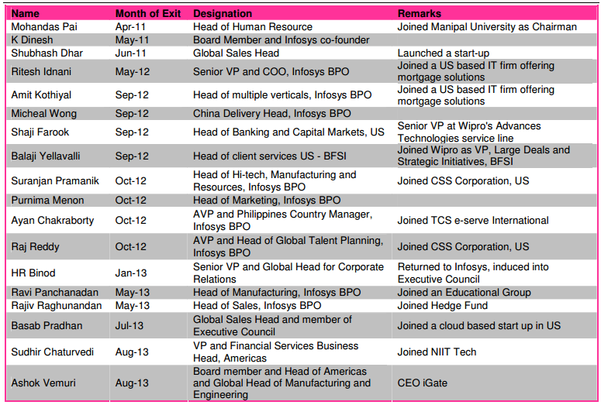
Core Management People Exits
Notes:
http://www.dreamsbroking.com/ResearchUpload/635150152491093750_INFY_Update.pdf

Slide 39
SWOT Analysis
Strengths
Weaknesses
Strong competency in Enterprise Resource Planning & Management(SAP), Supply Chain Management & Customer Relationship Management
Strong R & D Capability
Global delivery center
Leader in Oracle Application management service
Dependence on North America
Lack of thought leadership in Semiconductors in Hi Tech
Drastic changes in Core management level
Increasing attrition rate
Financial slowdown
Growing technology demand for growth in the high tech vertical
Growing BPO market
Positive outlook for SaaS market
Emergence of Cloud computing
Infosys High Tech Innovative Solutions
Intense competition
Fluctuation in current exchange rate
Opportunities
Threats

Slide 40
SWOT Analysis - Strengths
Strong competency
The Forrester report on SAP hailed Infosys as a company uniquely positioned to offer SAP consulting, planning and implementation services.
Infosys is an early adaptor of latest technologies like CRM 6.0, CRM 7.0.
High-Tech Distribution solution includes distributor price protection management and application integration.
Strong R & D Capability: Infosys Lab
Infosys lab is a dedicated research group comprising technology and domain-focused members and is built on the successes of the award-winning Software Engineering and Technology Labs (SETLabs).
Global delivery model
The global operations of Infosys enabled it to manage customer’s requirement through its 24-hour execution capabilities across multiple time zones and accelerate the delivery timings by simultaneously processing project components and enhances Infosys’s the cost competitiveness across geographic regions.
Leader in Oracle Application management service
Infosys won the Oracle Excellence Award for Specialized Partner of the Year – North America in both Financial Management and Human Capital Management categories, at Oracle OpenWorld 2012. It shows its strong competency in Oracle.
Notes:
http://globalbb.onesource.com/web/reports/ReportMain.aspx?KeyID=170721&Process=CP&CIK=1067491&Report=STRENGTHWEAKNESS

Slide 41
SWOT Analysis - Weakness
Dependence on North America
As reported by Infosys there is a sharp decline in their North America generated revenue by 1.7% from FY12 to FY13. There is a further decline of .8% in Q1 FY14. After the revised visa policy of US the scenario is going to be worsen. More than 60% of total revenue comes from this part of the world. So that is going to be a real weak point for Infosys.
Lack of thought leadership in Semiconductor
Infosys is very much focusing on implementation of SAP, CRM, SCM solutions. Infosys publish very much less number of white papers on semiconductors. It shows lack of thought leadership in semiconductor sector.
Drastic Changes in Infosys Core Management Level: Lack of Stability
A number of key executives have stepped down which has certainly shake the organization, as a result stability is yet to come in the organization.
Increasing attrition rate
LTM attrition rate touches 16.9% in Q1 FY14 sharp increase of .6% than FY13 attrition rate. The decreased utilization rate with increased attrition rate affects the overall cost structure and competitive position of Infosys in industry as compared to other competitors.
Financial Slowdown
For this Global slow down has impacted somehow the financial growth, that has surly impacted the High Tech part of Infosys.
Notes:
http://globalbb.onesource.com/web/Reports/ReportMain.aspx?KeyID=170721&Process=CP&CIK=1067491&Report=STRENGTHWEAKNESS

Slide 42
SWOT Analysis - Opportunity
Growing technology demand for growth in the high tech and manufacturing vertical
Gartner predicts that the high tech and manufacturing industries have more-technology plans, as external forces continue to shape the opportunity environment .Investments are likely to be made in CRM and PLM initiatives that would directly affect manufacturers' top-line results by delivering greater insight to manufacturers' segment expansion, service expansion or product portfolio management programs undertaken for tapping increased demand.
Growing BPO market
Infosys estimates Indian IT- BPO sector is estimated to grow from $101bn in FY 2012 to $225bn in FY 2020 at CAGR of 11% .So that is a huge area to opt for to Infosys.
Positive outlook for SaaS market
As far IDC’s prediction SaaS is going to grow at a good rate and report released by Zinnov Consultancy states that cloud services in India will be worth $1 billion by 2015. So SaaS can be a upcoming opportunity for Infosys which they should grab.
Infosys High tech Innovative Solution
Infosys provided High Tech solutions like Infosys Social Edge Platform, Infosys Digital Smart Home Gateway, Cloud services, Product engineering, Mobility services are going to be a hug potential of strength in upcoming future that is an huge opportunity.
Emergence of Cloud Computing
The company’s top line performance could be benefitted by the wide market acceptance of cloud computing. The markets of North American and European virtualization markets expected to grow at a CAGR of 8.5% during 2010-16. As per industry analysts, the markets for virtualization of North America and Europe will cross $12.3.8 billion and $94.7 billion, respectively in 2016. The company can count on cloud computing even if demand for IT infrastructure services decreases.
Notes:
Sources:
Infosys website IR presentation
http://www.crn.in/interview/-saas-market-is-growing-faster-than-on-premise-
http://globalbb.onesource.com/web/reports/ReportMain.aspx?KeyID=170721&Process=CP&CIK=1067491&Report=STRENGTHWEAKNESS

Slide 43
SWOT Analysis - Threat
Intense Competition
Infosys competes with established as well as evolving IT companies in the regional and global markets. In the technology services segment, the company competes with Tata Consultancy Services, Wipro, HCL Technologies, Mahindra Satyam and IBM. It also competes with consulting firms such as Accenture, Capgemini, and Deloitte, and services segments of large IT companies like HP, Dell and IBM. Some of the company’s competitors in the outsourcing services include Cognizant, Computer Sciences Corporation, HP and IBM Global Services.
Foreign Exchange risk
Infosys generates a major portion of its revenues in foreign currencies other than its functional currency, Indian rupee, The company’s major portion of revenues are derived from the US Dollar, the UK Pound Sterling, Euro and the Australian Dollar. Fluctuating foreign exchange rate will continue to affect the company’s operating performance. The way US Dollar fluctuating is definitely affecting company’s planning & implementation.
Notes:
http://globalbb.onesource.com/web/Reports/ReportMain.aspx?KeyID=170721&Process=CP&CIK=1067491&Report=STRENGTHWEAKNESS

Slide 44
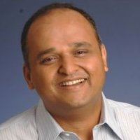
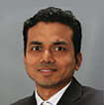
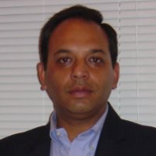
Key Executives and Profiles
Sanjay Jalona, SVP and Global Head, Hi-Tech, Manufacturing & Engineering Services, Infosys
He is responsible for defining and implementing strategy, setting vision and managing overall operations for these businesses.
He has held senior positions in client-facing and IT services delivery roles in the USA, Europe and India. Prior to his current role, he was responsible for the operations of Infosys’ Europe business, where he established and scaled operations in the region.
He did his graduation from BITS, Pilani
Komal Jain, Associate Vice President and Head of Semiconductor Sector - North America, Infosys
Komal joined the company in June 1998 and since then has played a variety of leadership roles in client services, sales & operations. Komal has been instrumental in helping clients develop and implement their Business Transformation programs, Global Sourcing strategy and IT initiatives. Komal participates in the steering committees of many of the key client relationships.
Komal holds a Bachelor's degree in Electronics Engineering from Kurukshetra University and an MBA from the Indian Institute of Management, Kolkata. Komal also is a marathon runner and lives in the Dallas, TX.
Anup Upadhayay, Senior Vice President & Head - Enterprise Mobility at Infosys
At present he is responsible for driving strategy, sales, solutions and engineering to meet business goals of the Enterprise Mobility business unit.
Earlier he hold a number of designations like VP & Head of Hi Tech Manufacturing, Delivery Head OF Financial Services in EMEA, Business Manager & Head in Marketing & Sales Support in West US & other positions.
He completed his MBA from IIM, Bangalore and engineering in Computer Science from University of Pune.
Notes:
http://www.linkedin.com/in/siddharthbohra
http://www.linkedin.com/profile/view?id=13682020&authType=name&authToken=wh4j&trk=prof-sb-browse_map-name
http://www.linkedin.com/profile/view?id=1336017&authType=name&authToken=dNrr&trk=prof-sb-browse_map-name
http://www.infosysblogs.com/infytalk/bloggers.html

Slide 45
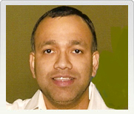
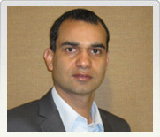
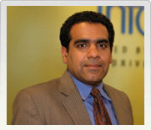
Key Executives and Profiles
Sandeep Mahapatra, Senior Principal - High-Tech & Manufacturing, Infosys
Sandeep comes with 16 years of experience in the areas of CRM and MDM strategy consulting.
His expertise in building CRM roadmaps, implementing advanced technology and business solutions, helps meet the diverse needs of revenue generation, business expansion and transformation of world class sales, service and marketing organizations.
Sandeep has a bachelor's degree in Electrical & Electronics Engineering from IIT Chennai, India, and holds an MBA in MIS from Texas Tech University.
Baljeet Chhazal, Associate Vice President, Hi-Tech and Manufacturing, Infosys
Baljeet Chhazal heads Oracle business for Infosys Manufacturing unit in Americas. His areas of specialization include supply chain management, large-scale program management, and ERP implementations.
Baljeet joined Infosys in 2000 and has worked in various leadership roles in business development and ERP consulting. He has nearly 20 years of experience and has been instrumental in winning several large deals in the business transformation area across global clients in retail, life sciences and manufacturing.
His responsibilities have included helping clients develop and implement creative sourcing strategies to optimize their IT expenditure.
He holds a degree in business management from Indian Institute of Management, Bangalore, India; and a degree in mathematics with honors from Punjab University, Chandigarh, India.
Hemant Asher, Associate Vice President, Hi-Tech and Manufacturing,Infosys
As a Global Client Partner for Hi-Tech and Manufacturing, Hemant heads one of the top 10 strategic accounts at Infosys. Previously, he has held different leadership roles at Infosys, including Head of Telecom (OEM vertical for Americas), Head of Telecom (Service Provider sector for India) and Senior Account Executive (Hi-Tech OEM accounts).
Hemant has over 22 years of experience in business management and entrepreneurship, with an interesting blend of roles that extend across consulting, technology startups and line functions.
He holds a degree in computer science from University of Mumbai, India, and a master of business administration degree from Capital University, Columbus, Ohio.
Notes:
http://www.infosys.com/oracle-openworld/agenda/speakers.asp

Slide 46


Key Executives and Profiles
Stephen R. Pratt, Managing Partner – Worldwide Consulting and Systems Integration
A leading business consultant for more than 25 years, Stephen has established a record of innovation in the industry. In 2004, he co-founded Infosys Consulting that set the standard for next generation service delivery by combining classic management consulting with global delivery.
Stephen joined Infosys after 12 years as a senior partner at Deloitte Consulting, where he established the company’s CRM practice. Before Deloitte, he worked for eight years at Booz, Allen & Hamilton. In 2003 and 2005, Consulting Magazine listed Stephen among the top 25 consultants in the world. He has been active in the World Economic Forum since 2004.
Stephen holds a bachelor's degree in Electrical Engineering from Northwestern University, and a master's degree from the George Washington University.
Chandrashekar Kakal, Senior Vice President, Global Head of Business IT Services
Chandrashekar Kakal is Global Head, Business IT services. He is responsible for application development, maintenance, testing, and infrastructure management services worldwide. As a Senior Vice President, Mr. Kakal oversees an organization comprised of 60,000 employees serving clients across all vertical industries from a global network of delivery centers.
Since joining the Infosys Enterprise Solutions in 1999, Mr. Kakal has played a key role in the company’s entry into the package implementation and related services market. In 2004, he was appointed Global Head of Enterprise Solutions which grew to account for more than 25% of the company’s total service revenues under his leadership. This unit was recognized as an industry leader in the sector by top analyst firms.
Mr. Kakal holds an MBA in International Business from the Asian Institute of Technology, Bangkok and a Mechanical Engineering degree from Bangalore University. He also holds a graduate diploma in Materials Management from Indian Institute of Materials Management.

Slide 47
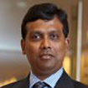


Key Executives and Profiles
Ravi Kumar S, Senior Vice President and Global Head of Consulting and Systems Integration business, Manufacturing Unit, , Infosys
Ravi Kumar S. is the global head of consulting and systems integration business in the manufacturing industry group at Infosys.
Additionally Ravi is the corporate leader for Oracle practice and is the head of the Hyderabad DC. He has over 18 years of experience in the consulting space incubating new practice lines, driving large transformational programs, evangelizing new business models and enabling disruptive technologies for market differentiation across industry segments.
Raghavan Subramanian, Associate Vice President, Cloud Computing, Center of Excellence, Infosys Labs, Infosys
Raghavan Subramanian has been with Infosys since 1994. He is with Infosys Labs, the R&D wing of Infosys, where he heads the centers of excellence (CoEs) for innovation, collective intelligence, big-data and performance-engineering.
He has strategized Infosys cloud service offerings, built multiple products in the areas of collective-intelligence, cloud, big-data and performance engineering.
He has also advised several enterprises in their application-rationalization exercises.
Raghavan was earlier the product manager for the Infosys Social Media platform, a SaaS offering, where he created several web 2.0 modules like video-uploads, blogs, online communities, forums, social analytics and integrated them in a holistic manner.
Arindam Banerji, Associate Vice-President and Unit Technology Officer, Products, Platforms, Solutions, Infosys
For the last 20 years, Arindam has been a technologist of some visibility within the industry. As one of the visionaries and chief technologist behind E-speak at HP, Arindam in the late-nineties laid the foundation for the next generation of computing, now broadly known as web services and Service-Oriented Architectures (SOA). His work on e- speak is now at the Smithsonian. He was also one of the early pioneers of semantic search.
At Infosys, he has been the head of technology consulting for the Manufacturing Business, and introduces several new technologies and solutions in the space of supply chain, business intelligence, collaboration and IT optimization. Currently, his focus is on pulling together the product play for Infosys in Business Analytics.
He has a B.Tech from IIT Kharagpur and a PhD from the University of Notre Dame, over 30 publications and 9 patents.
Notes:
http://www.infosysblogs.com/infytalk/bloggers.html

Slide 48
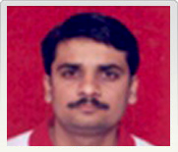
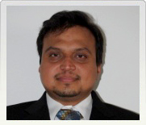
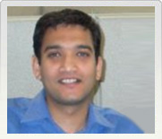
Key Executives and Profiles
Shankar Dronamraju, Principal Consultant – Manufacturing, Infosys
With 15 years of industry experience, Srinivas Dronamraju specializes in advising clients on industry best practices, as well as creation and implementation of generic- and industry-specific solutions for the industrial manufacturing, consumer packaged goods, and high-tech industry verticals.
Currently, Srinivas is the lead solution architect for a demand-to-deliver solution, which is a joint initiative between Oracle and Infosys. He is also the lead solution architect for a business transformation program of a high-tech networking major.
Srikanth Sripathi, Principal Consultant – Consulting and Systems Integration (C&SI), and Manufacturing, Infosys
Srikanth Sripathi has more than 14 years of experience in consulting, primarily in the manufacturing industry with focus on manufacturing and supply chain functions. He has worked in multiple implementations, rollouts, and transformation programs for various clients across the globe.
Srikanth holds a master's degree in computer science from the University of Mysore.
Rahul Shrikrishna Sane, Principal Consultant, Manufacturing, Infosys
Rahul Shrikrishna Sane is an EPM consultant with more than 13 years of experience in functional and consulting roles. This apart, Rahul has spent more than six years in client-facing roles and executing EPM engagements leveraging the global delivery model, brought to perfection by Infosys.
Rahul has rich expertise in defining innovative solutions to complex business problems. He has proven credentials in improving consolidation and reporting processes as well as helping realize automation and, in turn, process improvements and efficiency.
Notes:
http://www.infosys.com/oracle-openworld/archives/2012/speakers.asp

Slide 49
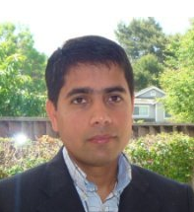
Key Executives and Profiles
Siddarth Bohra, Associate Vice President and Head, HiTech Vertical
Attached is a detailed linkedin profile
Notes:
http://www.linkedin.com/in/anandswam
http://www.linkedin.com/in/sudipsingh
http://www.infosysblogs.com/infytalk/bloggers.html

Slide 50
Thank You
Send your feedback / suggestions to the analyst team:
Aditi.Royghatak@tcs.com
D.Basak@tcs.com
Sonnet.Das@tcs.com
Aniket.Agao@tcs.com
October 15, 2013

